Slide 1




Firewall
InfoSec
Linux firewall based on the NetFilter Architecture, managed by IPTables commands.
Notes:
To view this presentation, first, turn up your volume and second, launch the self-running slide show.

Slide 2
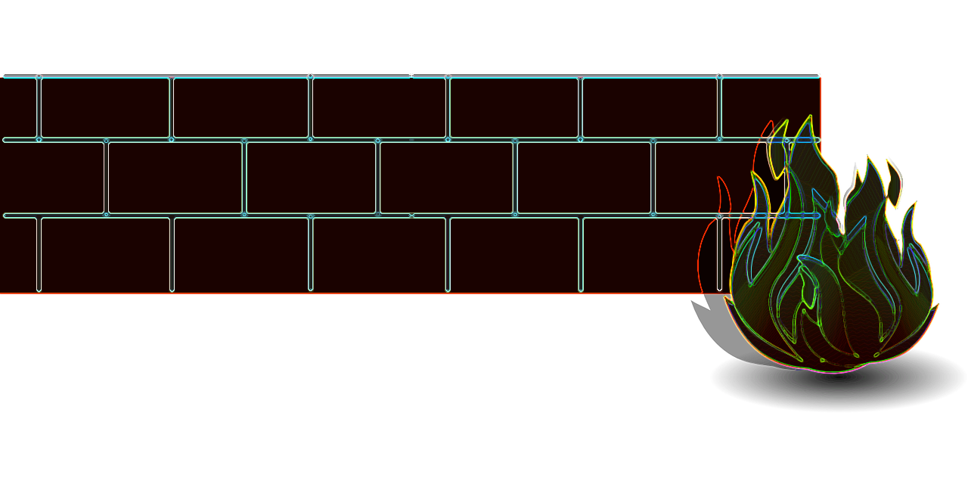
Eryk Szlachetka
Pamela Sabio
Student no: PJ1725110
Email: eryk1994@yahoo.ie
Student no: PJ1725106
Email: pamelalouisse@yahoo.com
Caoimhe Harvey
Student no: PJ1725102
Email: c14724965@mydit.ie
MEMBERS
Notes:
To view this presentation, first, turn up your volume and second, launch the self-running slide show.

Slide 3



Programming Language
Development Methodology
Code collaboration method
Testing Method
Timeline
Table Of Contents
Notes:
Do you have a main point? Consider putting just one word on the slide by itself. Want them to remember a few items? Don’t show everything at once. Instead, show one item at a time. Have a picture that expresses your idea? Scale that picture so that it fills the slide. Have a quote that says it all? Let it say it and remove everything else.

Slide 4






















































Building The FireWall
Notes:
…is destructive.

Slide 5
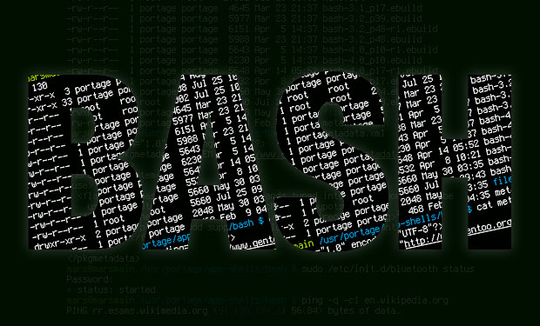
C
Programming
Language

Slide 6

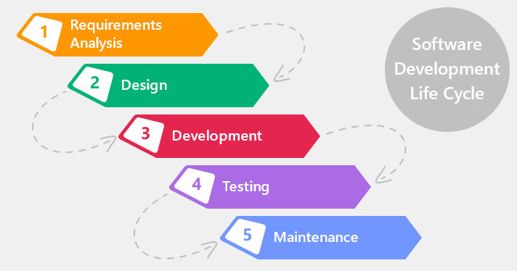

Notes:
For more than 20 years, Duarte has developed presentations…

Slide 7

https://github.com/EricSzla/Firewall

Slide 8

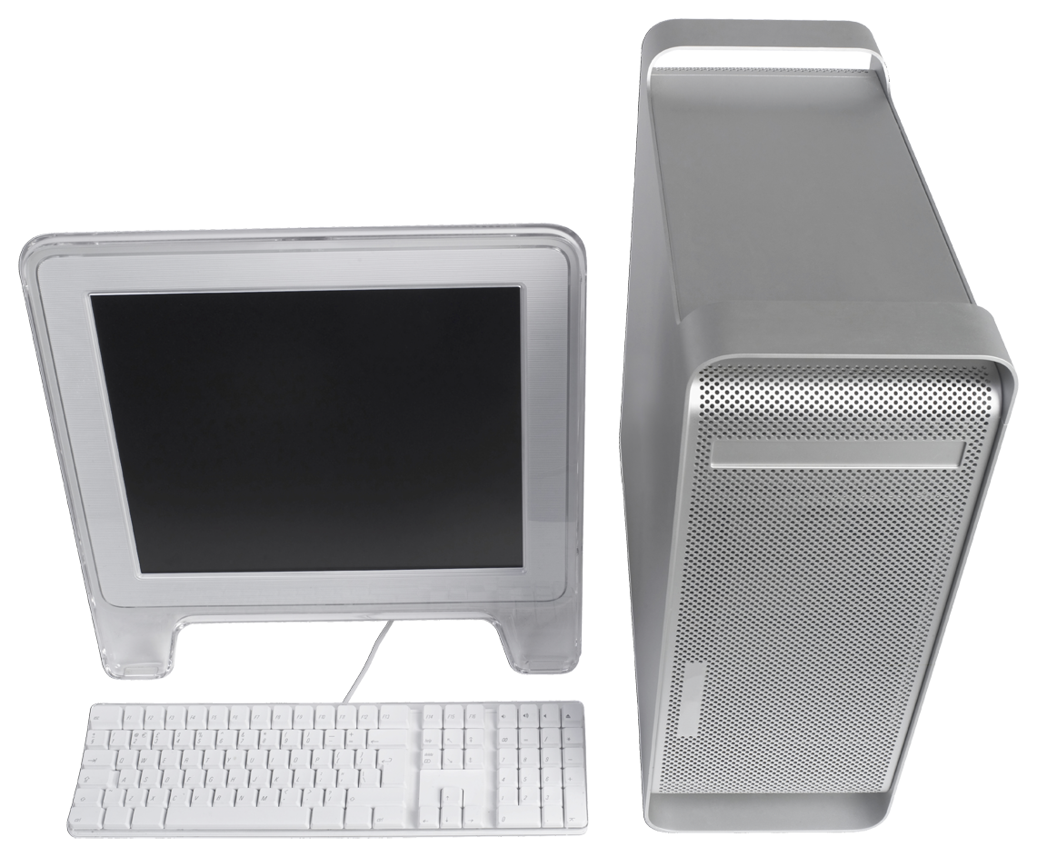

Mail
HTTP
Internet
Notes:
For more than 20 years, Duarte has developed presentations…

Slide 9






IpTables ?!
Chains !?
RESEARCH FIRST !
Notes:
Presentations are a powerful communication medium.

Slide 10
/04/17 Project Start
01/04 – 07/04 Requirements Analysis
07/04 – 14/04 Research + Design
14/04 – 01/05 Development
01/05 – 07/05 Testing
07/05 – 15/05 Finalizing the project
Timeline
Notes:
…increase company value,

Slide 11

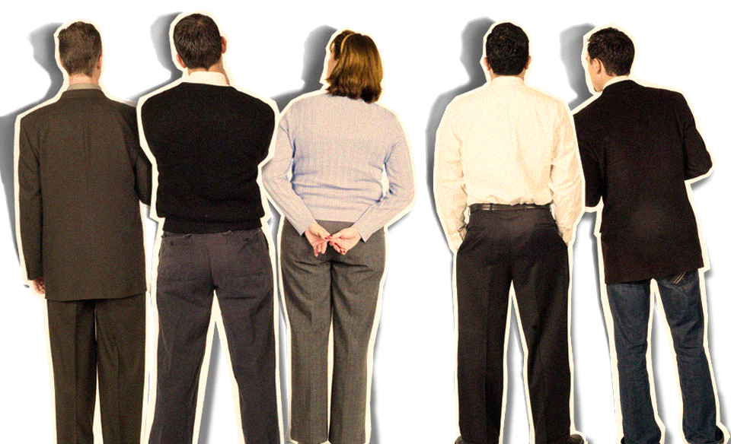
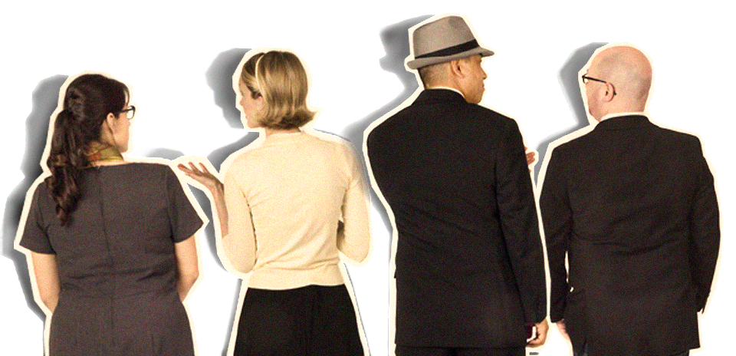
Questions ?
Notes:
Half of the people in your audience are verbal thinkers and the other half are visual.

